Slide 1
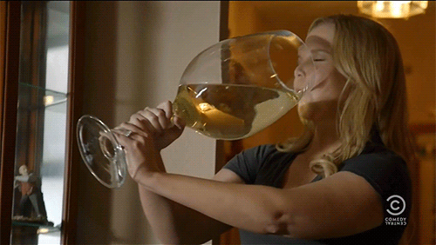
Wine
Intro to Data Science Final Project
Notes:
Vamsi

Slide 2



Team
Isabel Zimmerman
Z Best
Hellrasier 3.0
(Cause...it looks pretty)
Osaki Pokima
Saki-Saki
Volo Biou Sauvignon
(Sophisticated, like me)
Saivamsi Hanumanthu
Vamso the Extraordinaire
Sparkling Apple Cider
(Does this count?)
Notes:
All

Slide 3
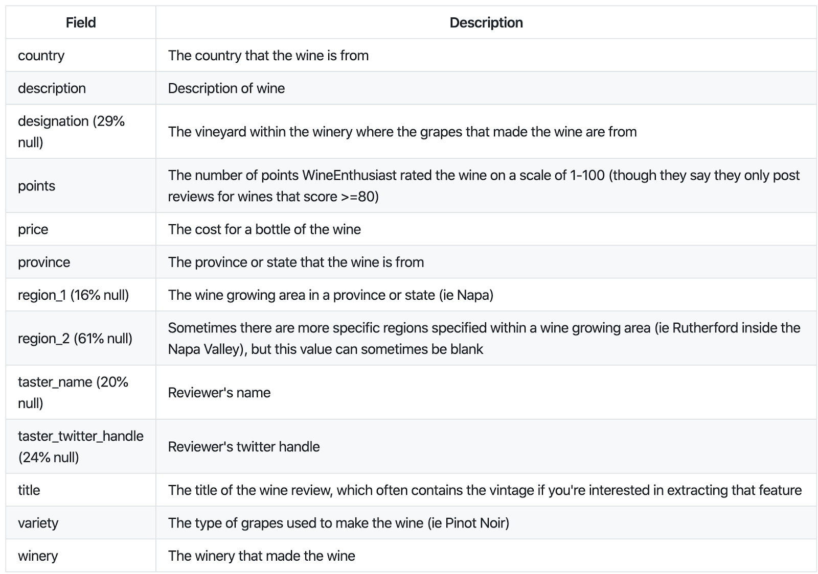
Dataset 1
130,000 reviews of wines from WineEnthusiast
Retrieved from Kaggle
Data curated by Zack Thout
Notes:
Izzy

Slide 4
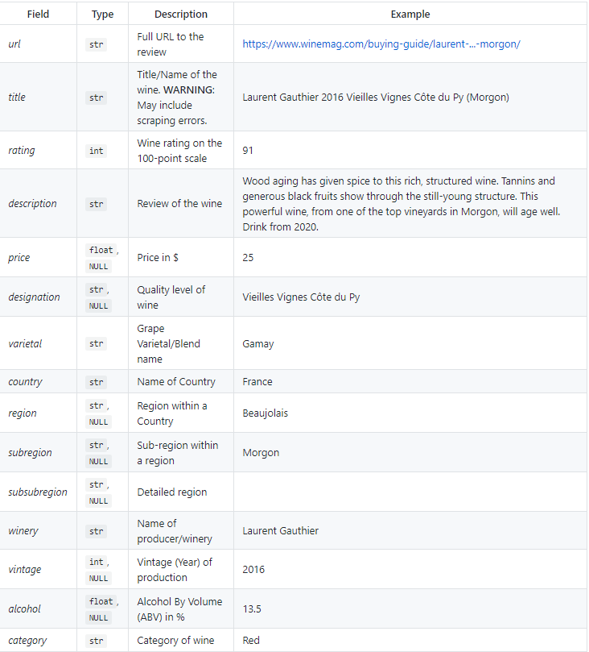
Dataset 2
250,000 reviews of wines from WineEnthusiast
Retrieved from GitHub
Data curated by Sanyam Kapoor
Notes:
Osaki The reason we had another dataset is to include additional information such as URL, alcohol percentage, and category whereas in dataset 1 , we had other information such as twitter handle

Slide 5
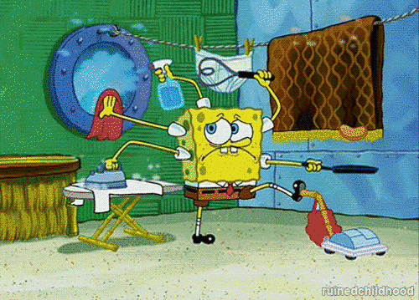
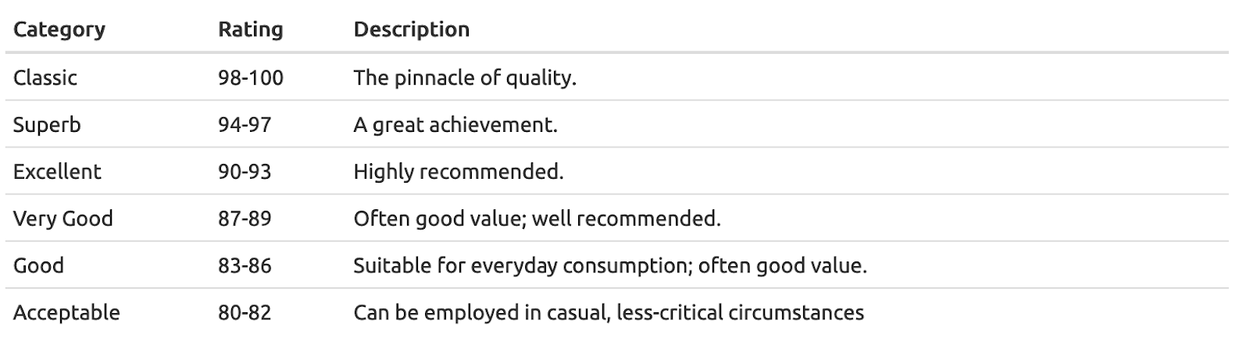
Data Preprocessing
Merged 17 CSV files to create DataFrame
Inner join both datasets (~120k)
Added Rating Category
Notes:
Vamsi
One of the short falls was this dataset was split among 17 different
Did a lot more cool things which can be found in the preprocessing section

Slide 6
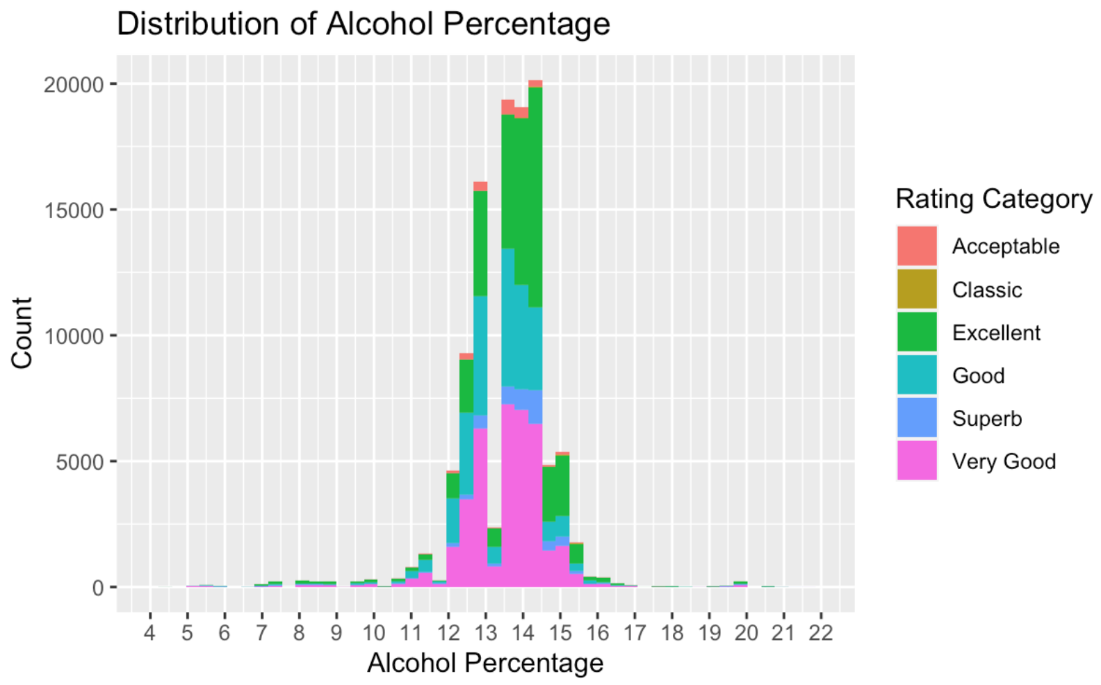
Alcohol Distribution
Majority of data falls between 12%-15% Alcoholic Content
Average Alcoholic Content (wines) according to Real Simple 11%-13%
Notes:
Izzy

Slide 7
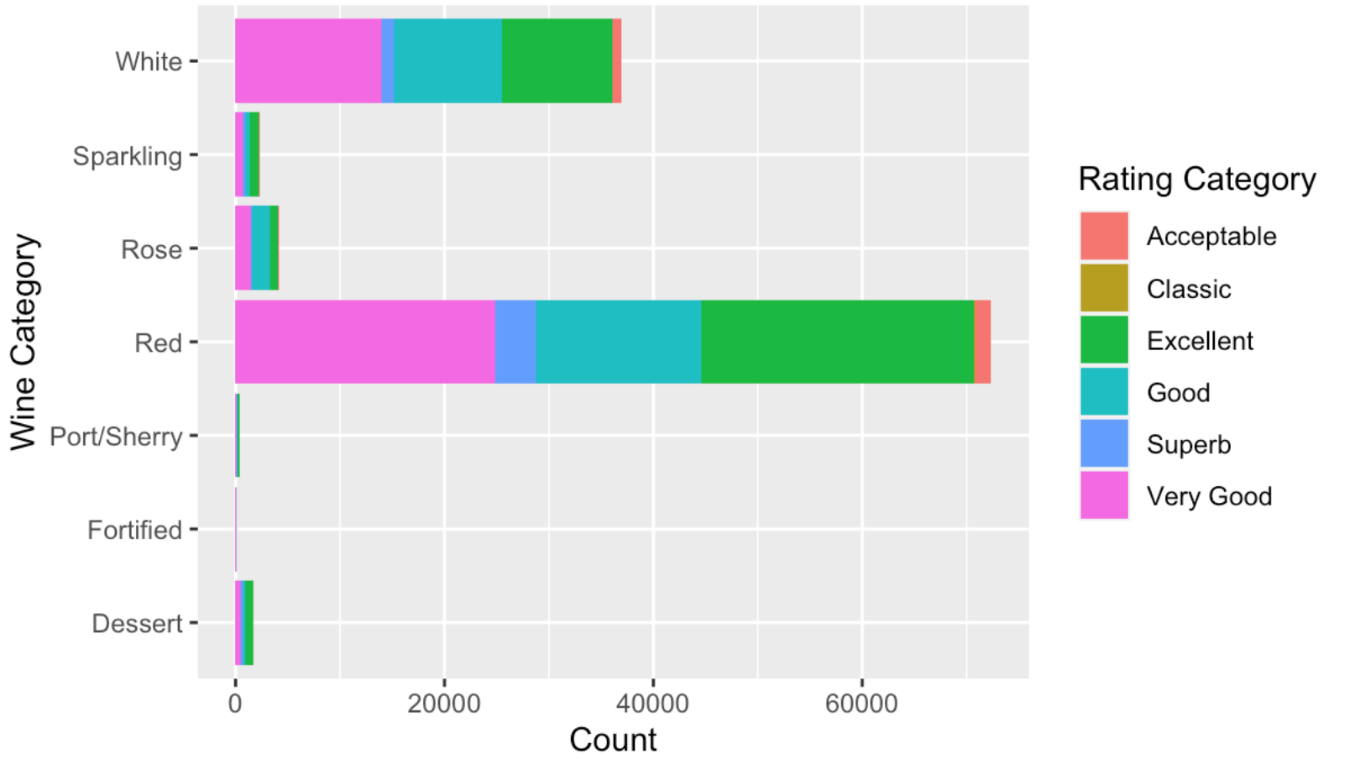
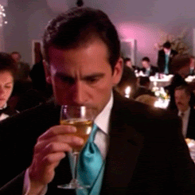
Wine Category
Notes:
Osaki Data visualization showing the different wine variety. As you can also see, the black lines at the end of the bar’s indicate standard error. The lower the standard error, the more accurate the data is and the spread of the data is smaller. How we got the variety, we did a group_by on variety, averaged the points, calculated standard error, arranged in descending order the avg points, and showed the top 10 wine varietys

Slide 8
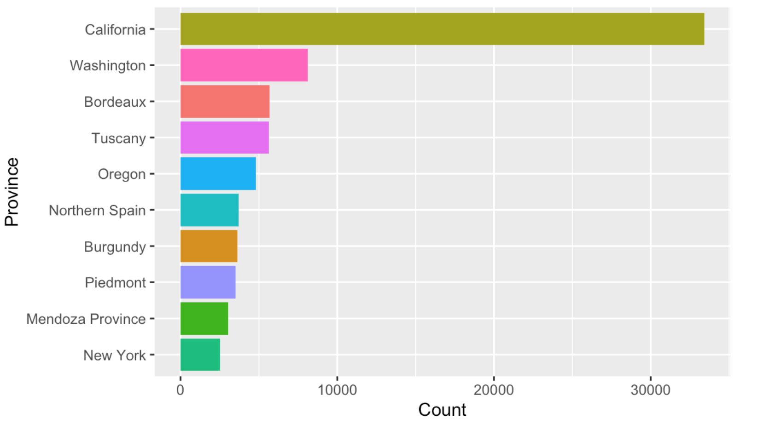
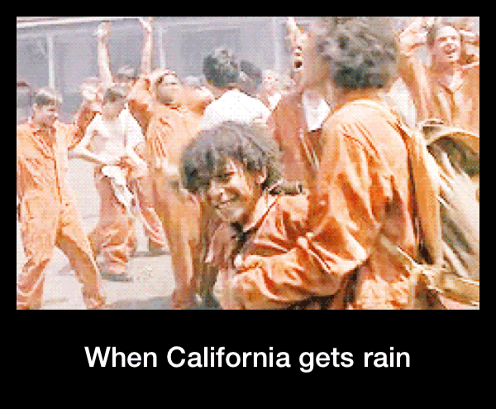
Province
Notes:
Osaki Data visualization showing the different wines per province. Chances are your wine is from California being the largest producer more than 3x Washington.

Slide 9
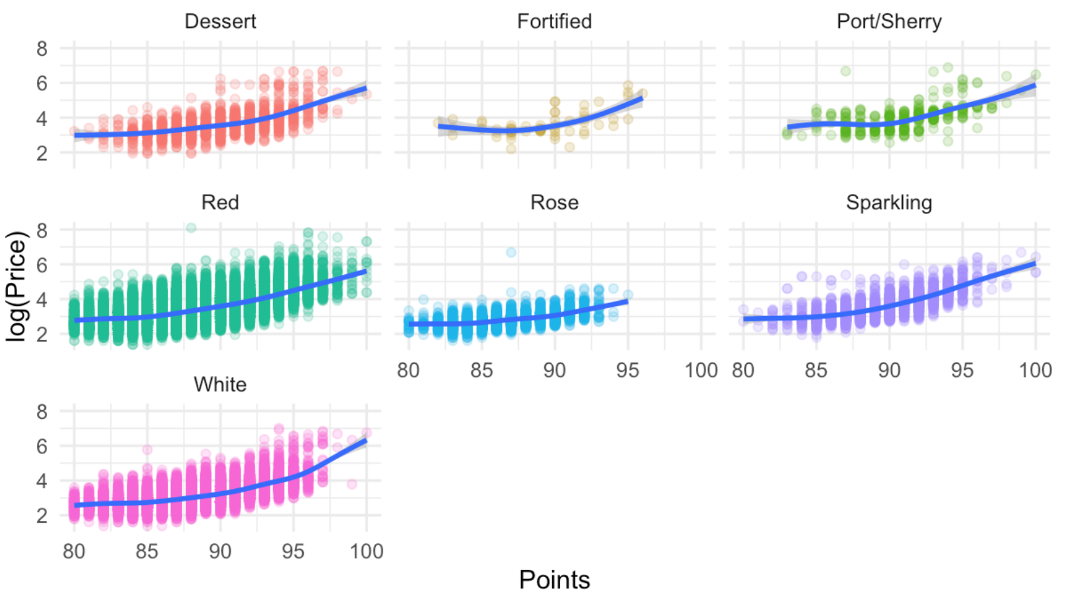
Price by Points
Used log to reduce skewness in graph
Quality of wine increases price increases exponentially
Notes:
Izzy

Slide 10
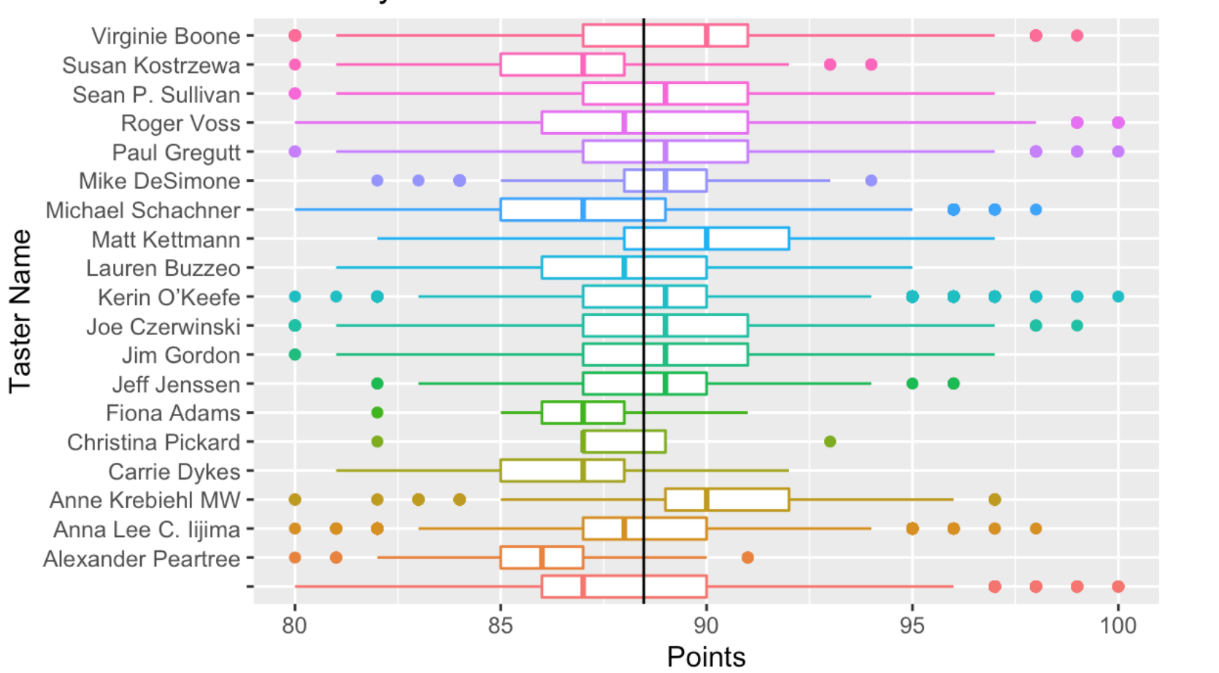

Who can we trust, really? (Taster data)
Notes:
Vamsi

Slide 11
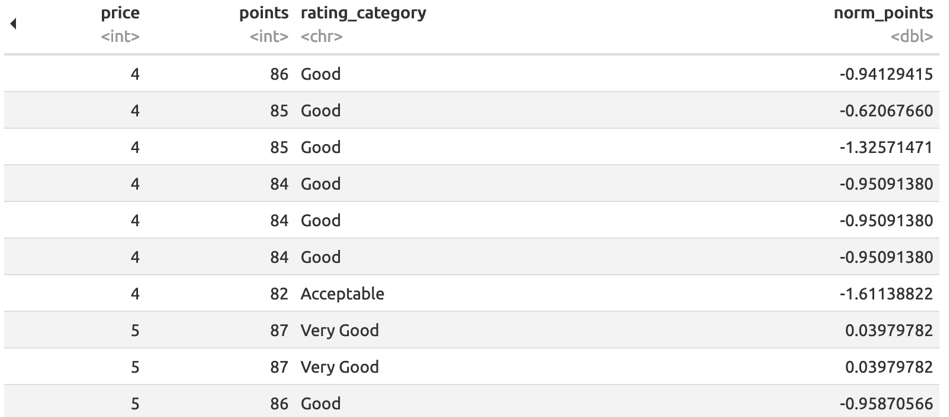
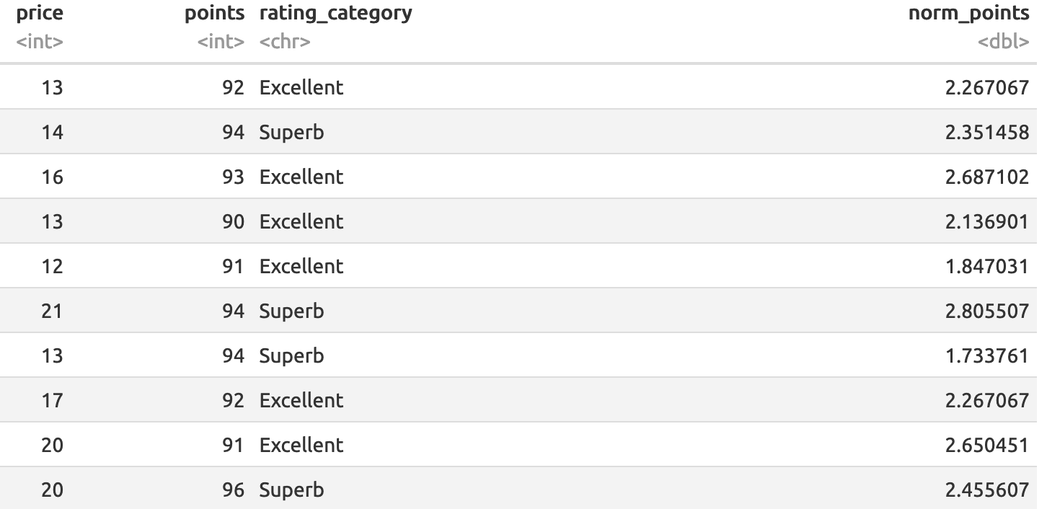
Best Value Wine
Sort by Points/Price
Sort by Normalized Points/Price
Notes:
Vamsi

Slide 12
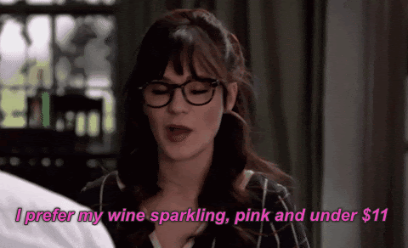
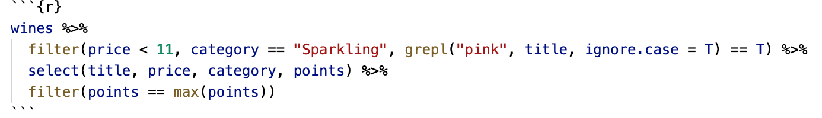
What’s Jess from New Girl’s favorite wine?
Notes:
Izzy

Slide 13
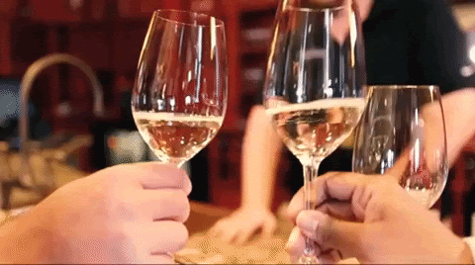
The End
Notes:
Izzy

Slide 14
Because I feel bad if I don’t credit all the gifs, I made this page
https://gifimage.net/wp-content/uploads/2017/09/amy-schumer-wine-gif-3.gif
https://media.giphy.com/media/10zsjaH4g0GgmY/giphy.gif
https://media2.giphy.com/media/k9yjgF1I7mX0k/200.gif
https://media1.giphy.com/media/VJihSxsVKL5tu/source.gif
https://media.giphy.com/media/3o6wO65AgKI8R9LoOc/giphy.gif
https://media.giphy.com/media/3osxY3Ju6p2jJbBo88/giphy.gif
https://giphy.com/gifs/traveloregon-oregon-travel-n3WqwXtEHrQ6axuMR4

